Slide 1
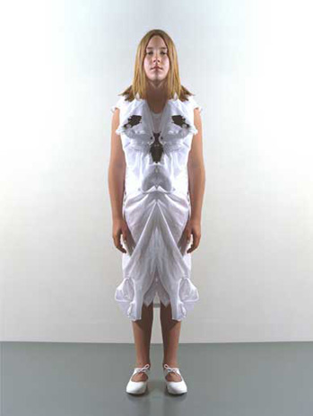
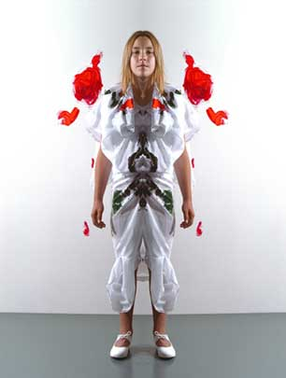
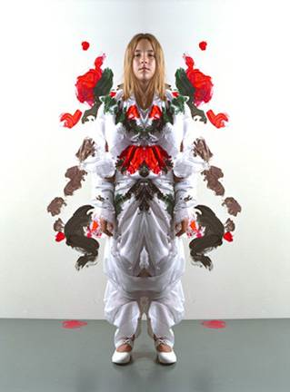
performance art

Slide 2
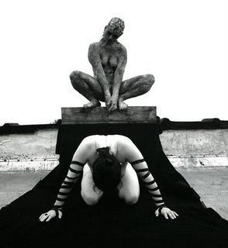

performance art
performance art is a type of artistic production that focuses upon actions, audiences and sites-
specific activities done in a particular location for a particular time.

Slide 3
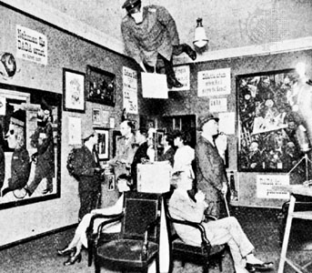
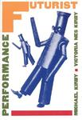
performance art
it was an avant-garde movement that has its artistic roots in the futurist and dada gatherings, demonstrations, protests, and unconventional exhibitions & poetry readings of the teens and twenties.
their activities were meant to confront, shock & outrage conventional society (the bourgeoisie) in an artistic response to the to the atrocities of WW1. they saw their rejection of traditional culture as clearing the way for new thinking and new
Institutions.
first international dada fair

Slide 4
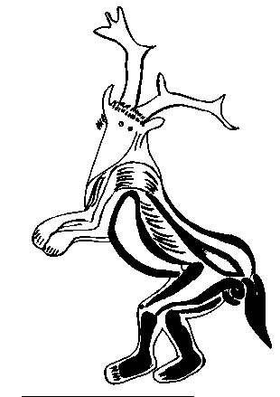
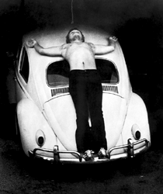
performance art
some push the roots of performance art much further back to the very beginnings of human culture. they argue that all art has its origin in performative symbolic actions such as rituals and rites of passage. many performance artists, especially in the 1960’s and 1970’s consciously cultivated the idea of the artist as shaman.
This is especially evident in the body works of artists such as chris burden, carolee schneemann
vito acconchi
chris burden tansfixed

Slide 5
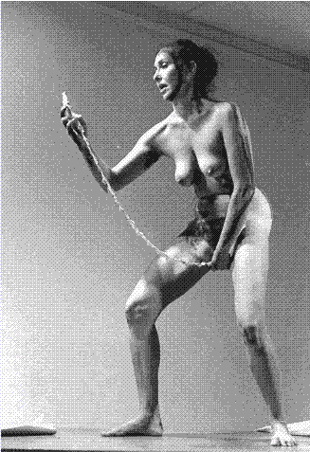
performance art
some push the roots of performance art much further back to the very beginnings of human culture. they argue that all art has its origin in performative symbolic actions such as rituals and rites of passage. Many performance artists, especially in the 1960’s and 1970’s consciously cultivated the idea of the artist as shaman.
This is especially evident in the body works of artists such as chris burden, carolee schneemann
vito acconchi
schneeman interior scroll

Slide 6
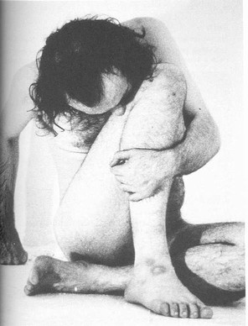
performance art
some push the roots of performance art much further back to the very beginnings of human culture. they argue that all art has its origin in performative symbolic actions such as rituals and rites of passage. Many performance artists, especially in the 1960’s and 1970’s consciously cultivated the idea of the artist as shaman.
This is especially evident in the body works of artists such as chris burden, carolee schneemann
vito acconchi
vito acconci trademarks

Slide 7
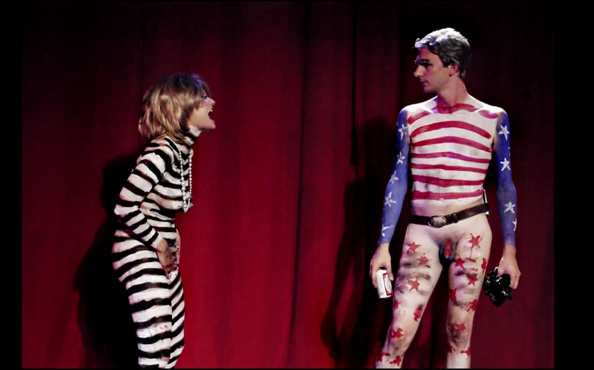
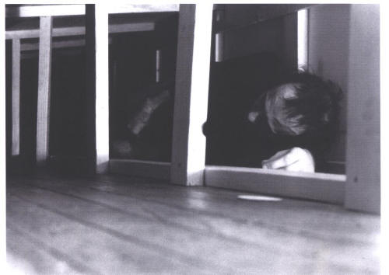
performance art
Often these early performance works dealt with taboo, social isolation and the transformative/cathartic role of artist as the hero/martyr/fool.
karen finley
vito acconci seedbed

Slide 8


performance art
individual artist actions are still a common approach to performance, but as early as the 1950’s a more social form of performance art emerged, focused not so much on the role of the shaman but more on the social character of ritual. allan Kaprow’s Happening’s and the activities of the artist collective fluxus focused on involving the audience as participants rather than as spectators and they were very interested in blurring or eliminating the distinctions between art and life.
fluxus artist yoko ono
cut piece

Slide 9
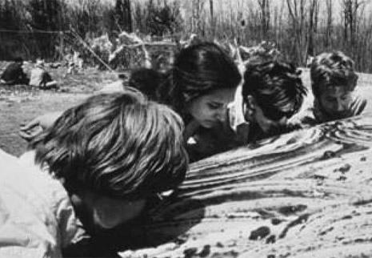
performance art
individual artist actions are still a common approach to performance, but as early as the 1950’s a more social form of performance art emerged, focused not so much on the role of the shaman but more on the social character of ritual. allan kaprow’s happenings and the activities of the artist collective fluxus focused on involving the audience as participants rather than as spectators and in blurring or eliminating the distinctions between art and life.
allan kaprow untitled happening
(licking snow off a car)

Slide 10
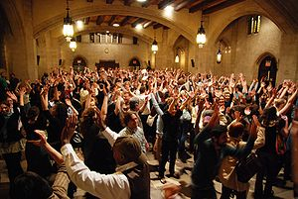
performance art
a theater of the oppressed workshop
In new york city
Much of performance art’s lineage is derived from the visual arts, especially conceptual art, but it also has drawn from music, such as the work of john cage, and from theater, such as augusto boal’s Theater of the Oppressed.

Slide 11
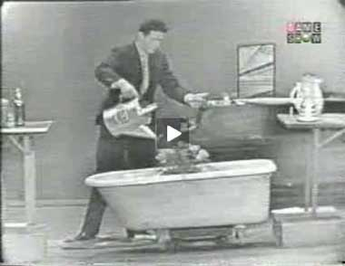
performance art
a performance of cage’s water walk
much of performance art’s lineage is derived from the visual arts, especially conceptual art, but it also has drawn from music, such as the work of john cage, and from theater, such as augusto boal’s Theater of the Oppressed.

Slide 12
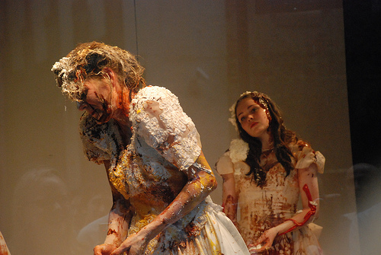
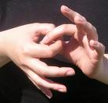
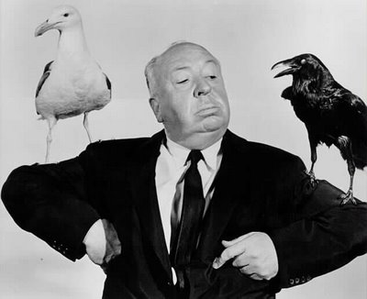
performance art
some key concepts:
significant gesture-
a simple action or a body movement that takes on special significance through repetition, exaggeration, isolation, or context
top from we are karen finley
right from alfred hitchcock presents

Slide 13
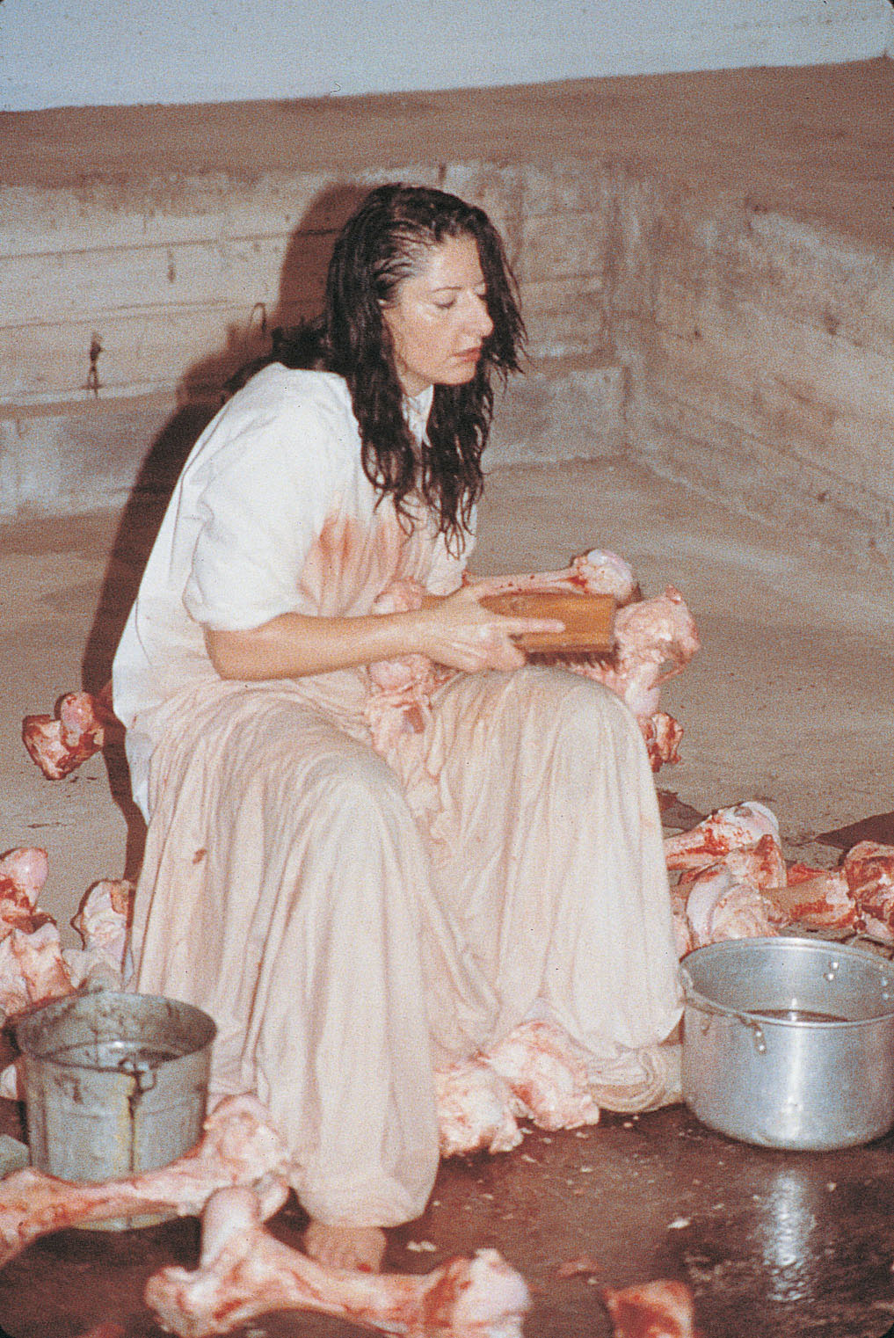
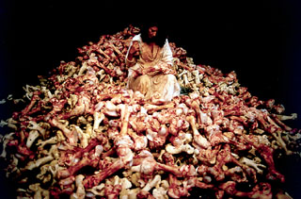
performance art
some key concepts:
significant gesture-
a simple action or a body movement that takes on special significance through repetition, exaggeration, isolation, or context
maria abromovic balkan baroque

Slide 14
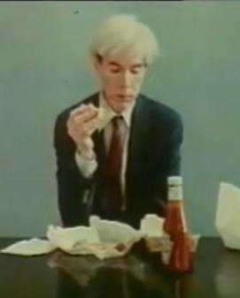

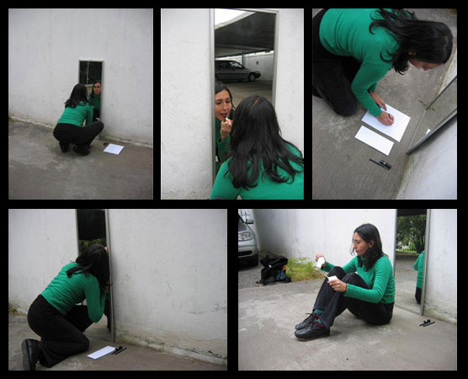
performance art
some key concepts:
reality vs. fiction:
performance art is typically enacted (act out), not acted (act as) in the sense that most performance art is not heavily scripted.
?
link to andy warhol eating a
cheeseburger
purfopuerto collaborative solas

Slide 15
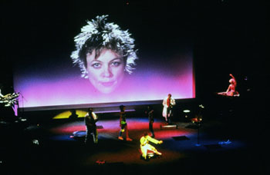
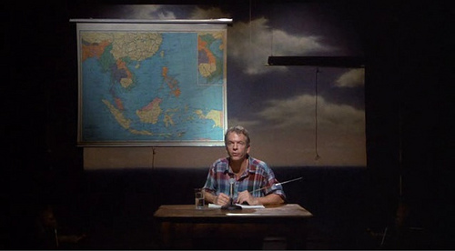
performance art
some key concepts:
reality vs. fiction:
however performance art does often involve role play and some of the best known artists associated with this genre such as laurie anderson, karen finley and spalding gray perform works that are highly scripted or theatrical.
laurie anderson united states
?
spalding gray swimming to cambodia

Slide 16
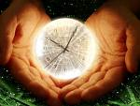
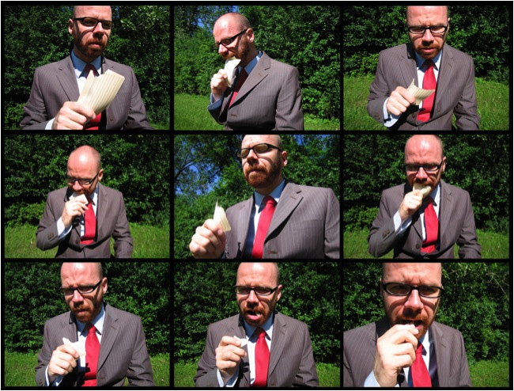
performance art
some key concepts:
serial, synchronous & asynchronous:
serial- events in the performance
happen one after another
gary setzer keypunch operator

Slide 17
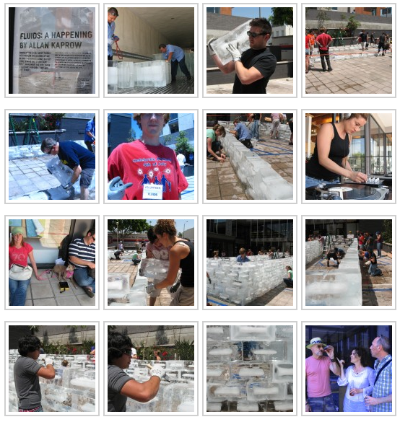
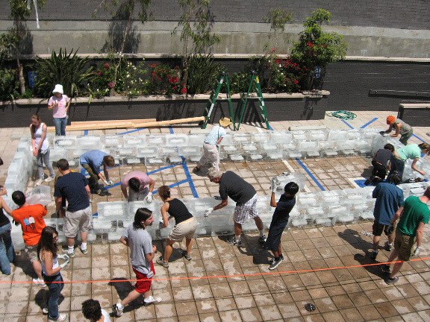
performance art
some key concepts:
serial, synchronous & asynchronous:
serial- events in the performance happen one after another
synchronous- events happen concurrently at the same time
allan kaprow fluids

Slide 18
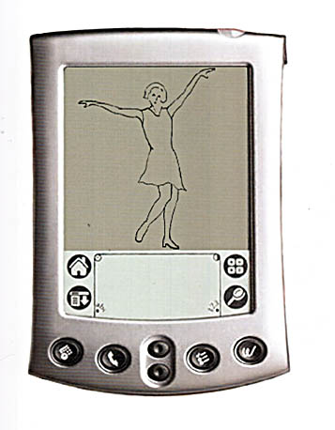
performance art
some key concepts:
serial, synchronous & asynchronous:
serial- events in the performance happen one after another
synchronous- events happen concurrently at the same time
asynchronous- events in the performance not occurring at the same time, usually at a geographic remove
james buckhouse tap
tap was a virtual dance school for animated pda characters that practiced and learned from each other and from the pda owners

Slide 19
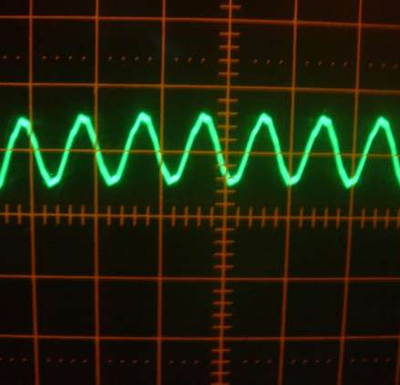
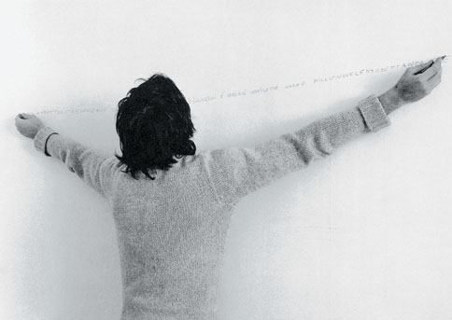
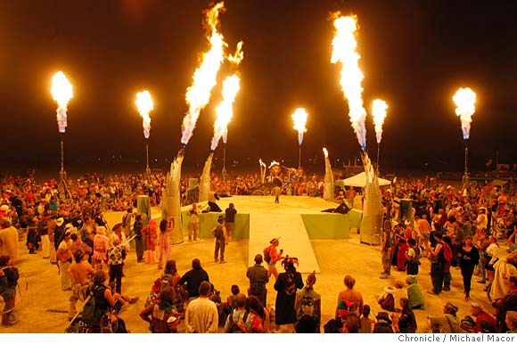
performance art
some key concepts:
scope and duration:
the size and length of the performance
left alighero e boetti writing with
both hands small scope and
short duration
right burning man
large scope and long duration

Slide 20
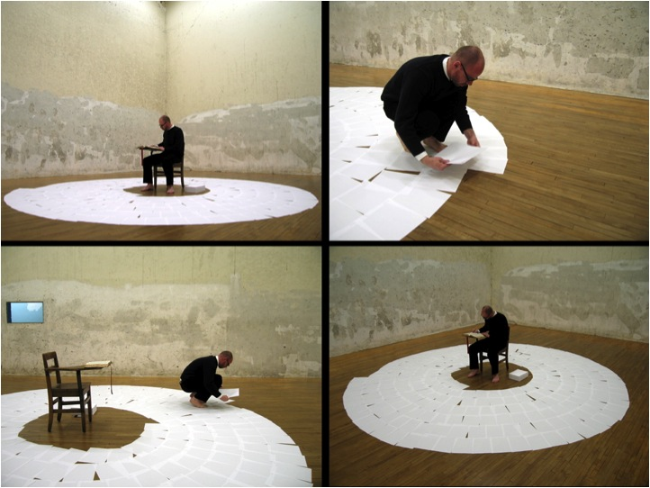

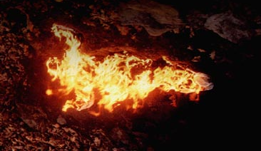
performance art
Some key concepts:
intensity:
emotional & visual impact, the degree of audience immersion or performer investment
actions become intensified through repetition, duration, symbolism, context or difficulty
gary setzer
intensity through repetition & isolation
ana mendieta
intensity through symbolism & visual
impact

Slide 21
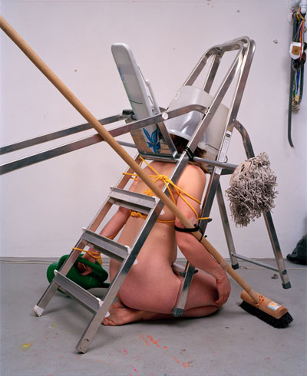

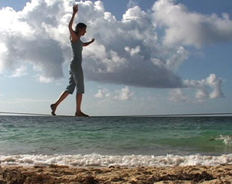
performance art
Some key concepts:
character of site or setting:
context of performance; public/private; formal/informal; institutional/ domestic; site specific/site neutral
scale
melanie bonajo site neutral
janine antoni site specific

Slide 22
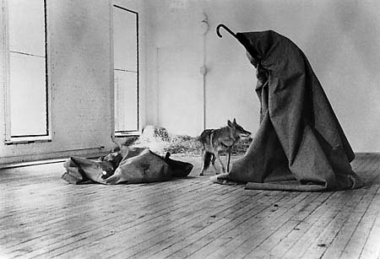

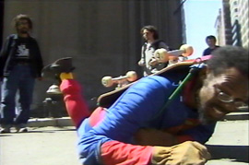
performance art
some key concepts:
audience interaction:
relationship of the audience to the action; the size, location/proximity of audience
participatory/interactive
passive
confrontational
formal/informal; informed/uninformed
joseph beuys i love america &
america loves me
audience: passive; formal; informed
william pope l. the great white way
audience: informal; uninformed; (mostly) passive;
(somewhat) confrontational

Slide 23
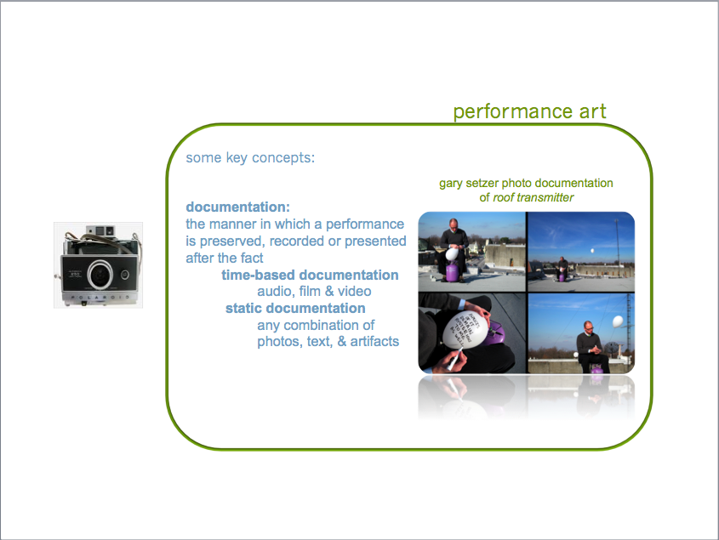

Slide 24
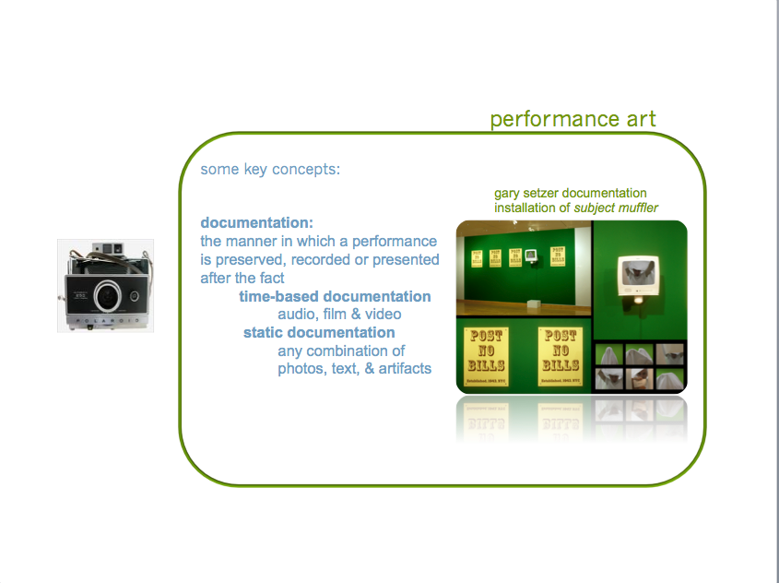

Slide 25
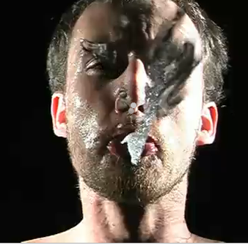
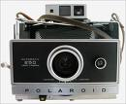
performance art
some key concepts:
documentation:
the manner in which a performance is preserved, recorded or presented after the fact
  time-based documentation
  audio, film & video
  static documentation
  any combination of photos, text, & artifacts
click for bruce nauman’s fountain

